Slide 1


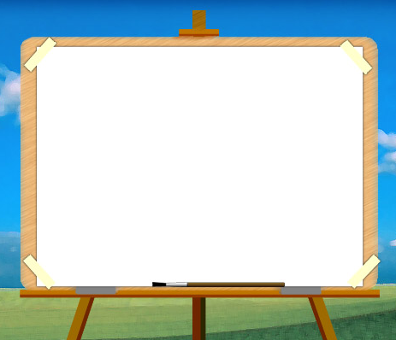


Unit
8
JUST GO FOR IT Lesson 2: Does it make you nervous?

Slide 2
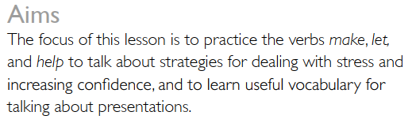
Lesson 2: Does it make you nervous?

Slide 3
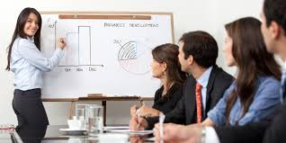
Where is she? What is she doing?
Who are the other people?
How is she feeling?

Slide 4
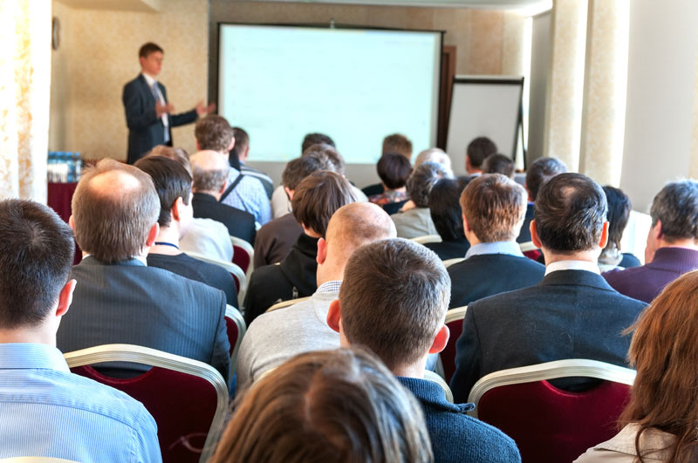
Have you ever …………………..?
Have you ever given a talk to a group of people in a university or college?
Have you ever given a lesson to a group of people in a school?
Have you ever given a lecture to a group of people in a school?
Have you ever made a presentation to a group of people in a company?
Have you ever made a speech to a group of people at a wedding?

Slide 5

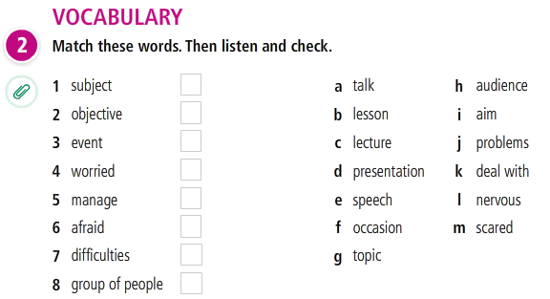
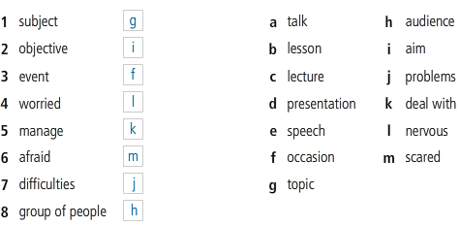
Words of similar meaning
T 1.16

Slide 6
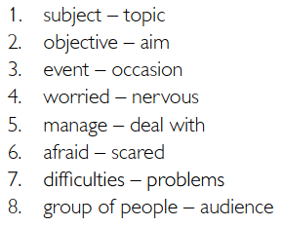
Vocabulary
Words of similar meaning

Slide 7
SPEAKING
Have you ever ……..?
……… given a talk ……… ………...university or college?
……….given a lesson ………………school?
……….given a lecture ………………school?
……….made a presentation …………company?
……….made a speech ……………….wedding?

Slide 8
SPEAKING
Have you ever ……..?
1. Have you ever given a talk to a group of people at a university or college?
2. What was the occasion?
3. What was the occasion?
4. What was the topic?
5. Who were the audience?
6. What was your aim?
7. How did your talk go?
8. Were there any problems? If so, how did you deal with them?
9. Were you nervous – or even scared before you started? If so, Why?

Slide 9
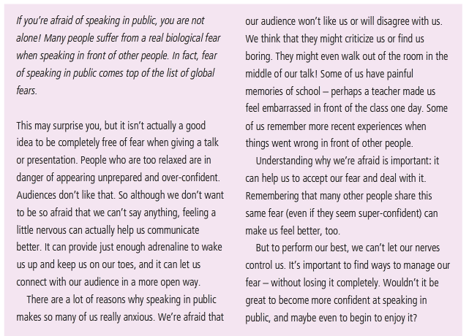
READING
Does it make you nervous?

Slide 10
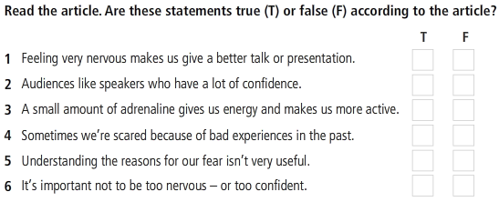
READING
Does it make you nervous?

Slide 11
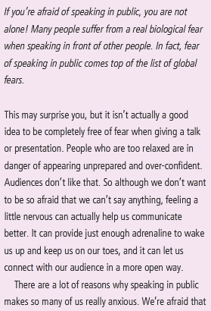
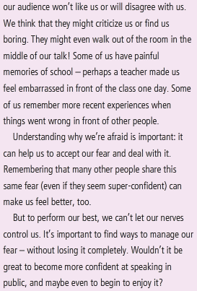
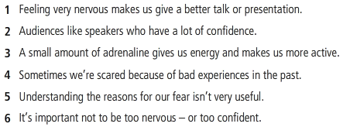
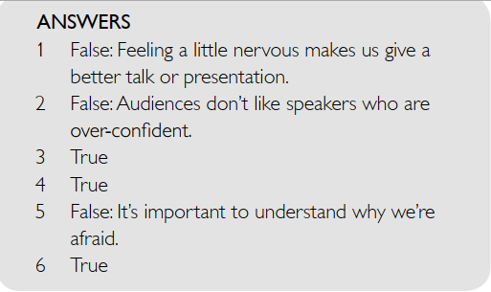
READING
Does it make you nervous?
Read the article. Are the sentences True or False.

Slide 12
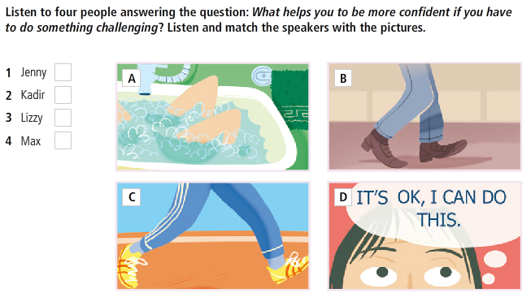
LISTENING
What helps you to be more confident?

Slide 13
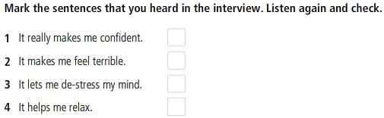
LISTENING
What helps you to be more confident?

Slide 14
GRAMMAR
Make / let / help
Make / let / help + object + infinitive
Looking at the screen for a long time makes your eyes become worse.
Relaxing lets me refresh my mind.
Doing exercise helps me have a good shape.

Slide 15
References
Grammar: make / let / have + Object + Verb
https://www.youtube.com/watch?v=RtFLyRd-37w
Listening
https://www.youtube.com/watch?v=l_NYrWqUR40

Slide 16
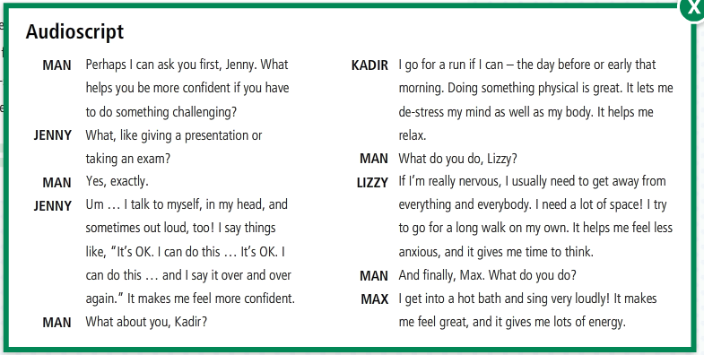

Slide 17
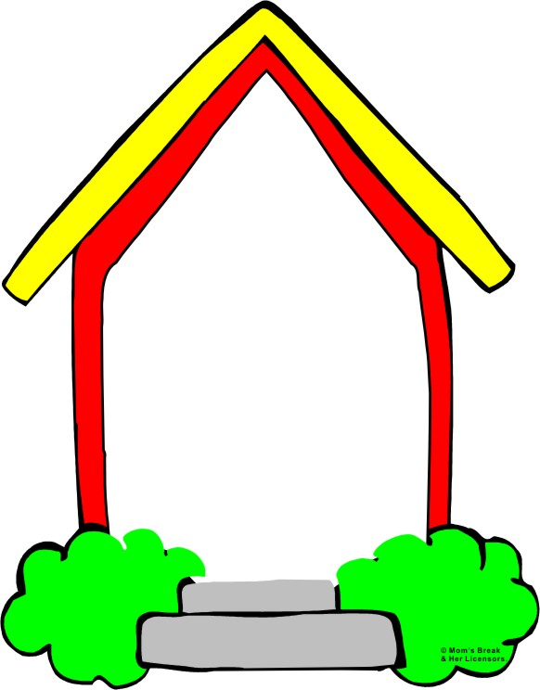
HOMEWORK
Do the exercises in Workbook

Slide 18
READING
My favourite country
Read and choose if the sentence is True or False.
1. She loves Japan and Mexico because she loves the food there.
T
T
2. Mexican food is the spiciest.
3. There are varied types of cooking in Britain.
T
4. Japanese food even has chilies (chillies) on.
F
5. Japanese has the healthiest food.
T
6. She didn’t like sushi.
F
7. She thought Japanese language was easier than Spanish language.
F
8. Mexico is the sunniest country.
T

